Slide 1
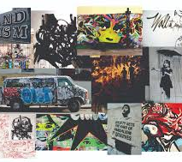
ICT LAB 4(TASK1)
ESHAL AYUB
REGISTRATION NO:B25F1061AI100
DEPARTMENT: BSAI
SECTION:RED

Slide 2
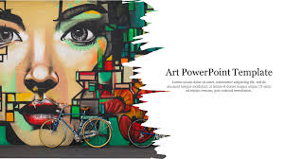
Aesthetic & Creative Topics
The Psychology of Colors in Art how colors affect emotions and moods.
The Evolution of Art from Cave Paintings to Digital Media a time-travel through creativity.
The Power of Minimalism in Modern Art less really is more.
Symbolism in Van Gogh’s Paintings what his stars, sunflowers, and skies really mean.
Art and Mental Health how creating and viewing art heals the mind.

Slide 3
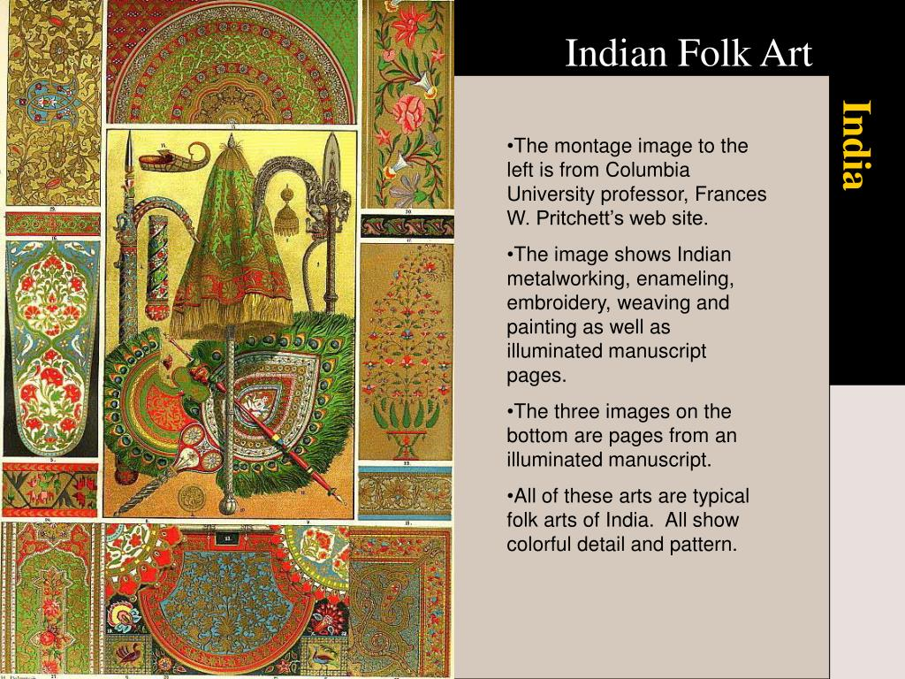
Cultural & Historical Topics
Islamic Art and Geometric Patterns beauty in symmetry and faith.
The Renaissance: A Rebirth of Art and Ideas how art reshaped the modern world.
Women in Art History forgotten geniuses and their impact.
Pakistani Truck Art turning highways into moving galleries.
Mughal Miniature Paintings the fine details of royal storytelling.

Slide 4

Modern & Innovative Topics
The Rise of AI Art can a machine be an artist?
NFTs and the Digital Art Revolution how artists are selling pixels for millions.
Street Art and Social Change from graffiti to global movements.
The Role of Art in Climate Awareness painting a greener future.
Virtual Reality in Art the future of immersive creativity.

Slide 5


